Slide 1
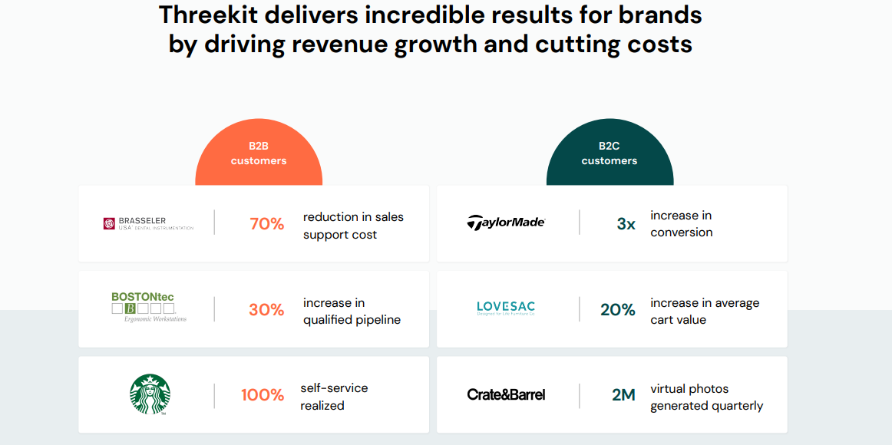
Three kit's Customer’s Testimonies

Slide 2
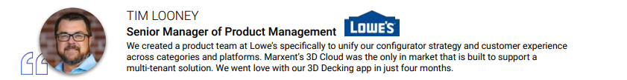
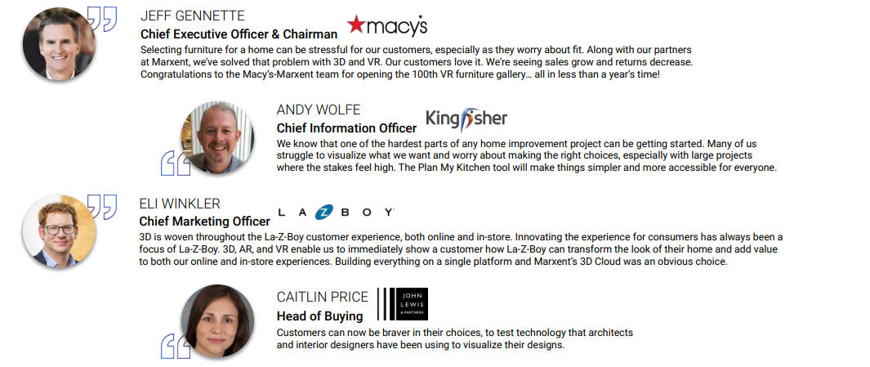
Maxent's Customer’s Testimonies

Slide 3
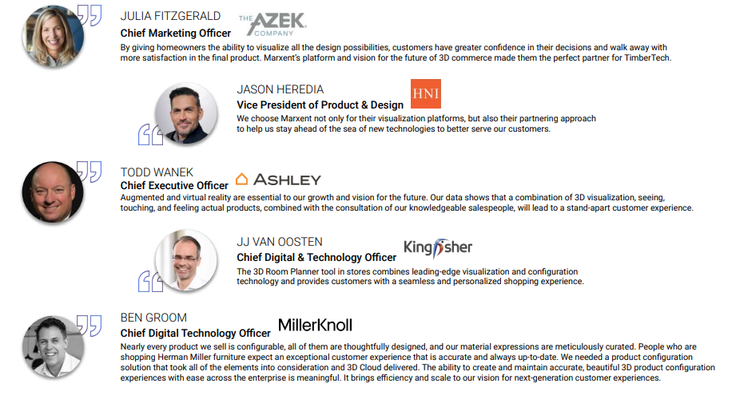
Maxent's Customer’s Testimonies

Slide 4
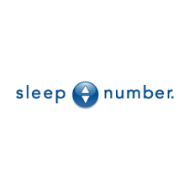
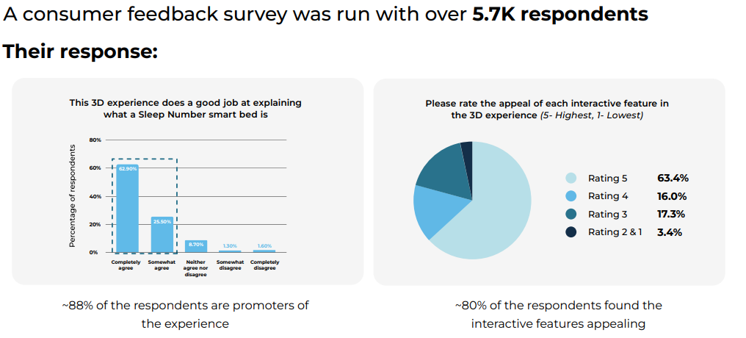
Avataar.Ai Customer Testimony
88% Visitors found the 3D simulator experience helpful in explaining the USP of the smart bed
8x Higher engagement time vis-a-vis 2D banners

Slide 5
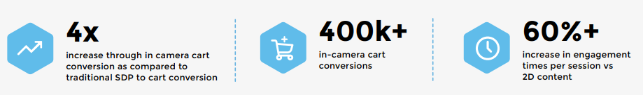

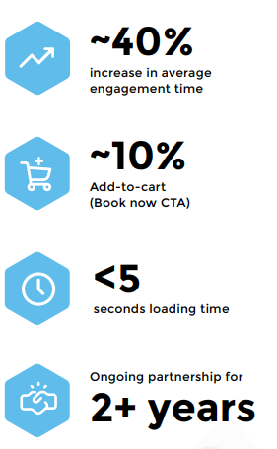
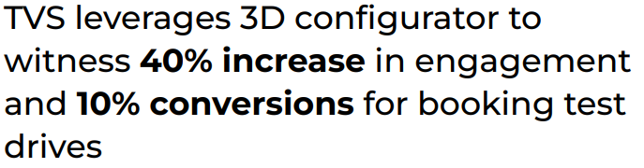

Avataar.Ai Customer Testimony

Slide 6
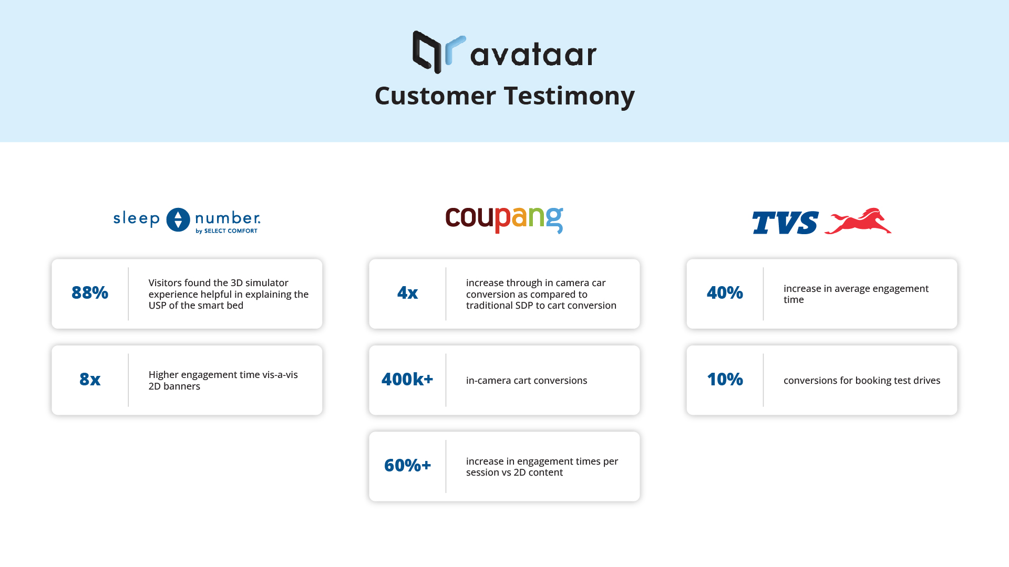

Slide 7
Pricing
Avataar.ai Pricing :
100$ per SKU
1 year contract
Base Price : USD 830/month i.e 9960$ Yearly
Inclusions :
Creation of Models - 100
Impressions - 150k
Extra Models - $100 / modelAvataar.ai Pricing :
100$ per SKU
1 year contract
Base Price : USD 830/month i.e 9960$ Yearly
Inclusions :
Creation of Models - 100
Impressions - 150k
Extra Models - $100 / model
Marxent 3D Cloud Pricing:
Base Price : $5k/month i.e 60,000$ Yearly
Inclusions:
Product Renders & 360 Spins (2D)
WebAR API
Extra Models: - $100 to $200 / model Depending on the features
ThreeKit Pricing :
Base Price : $7500K/Month i.e 90,000 Yearly
Extra Models: $100 to $200 / model Depending on the features

Slide 8
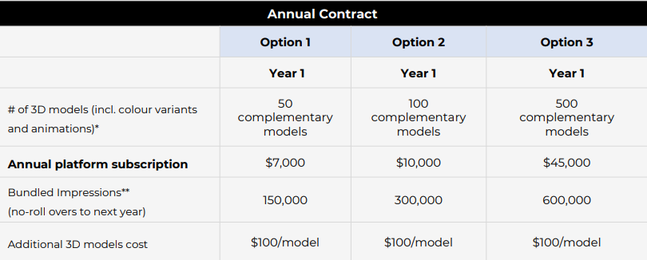
Avataar.Ai Pricing

Slide 9
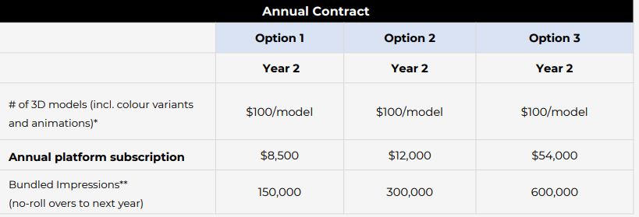
Avataar.Ai Pricing

